Slide 1
The miracle
嵊州市2021年5月模考续写

Slide 2
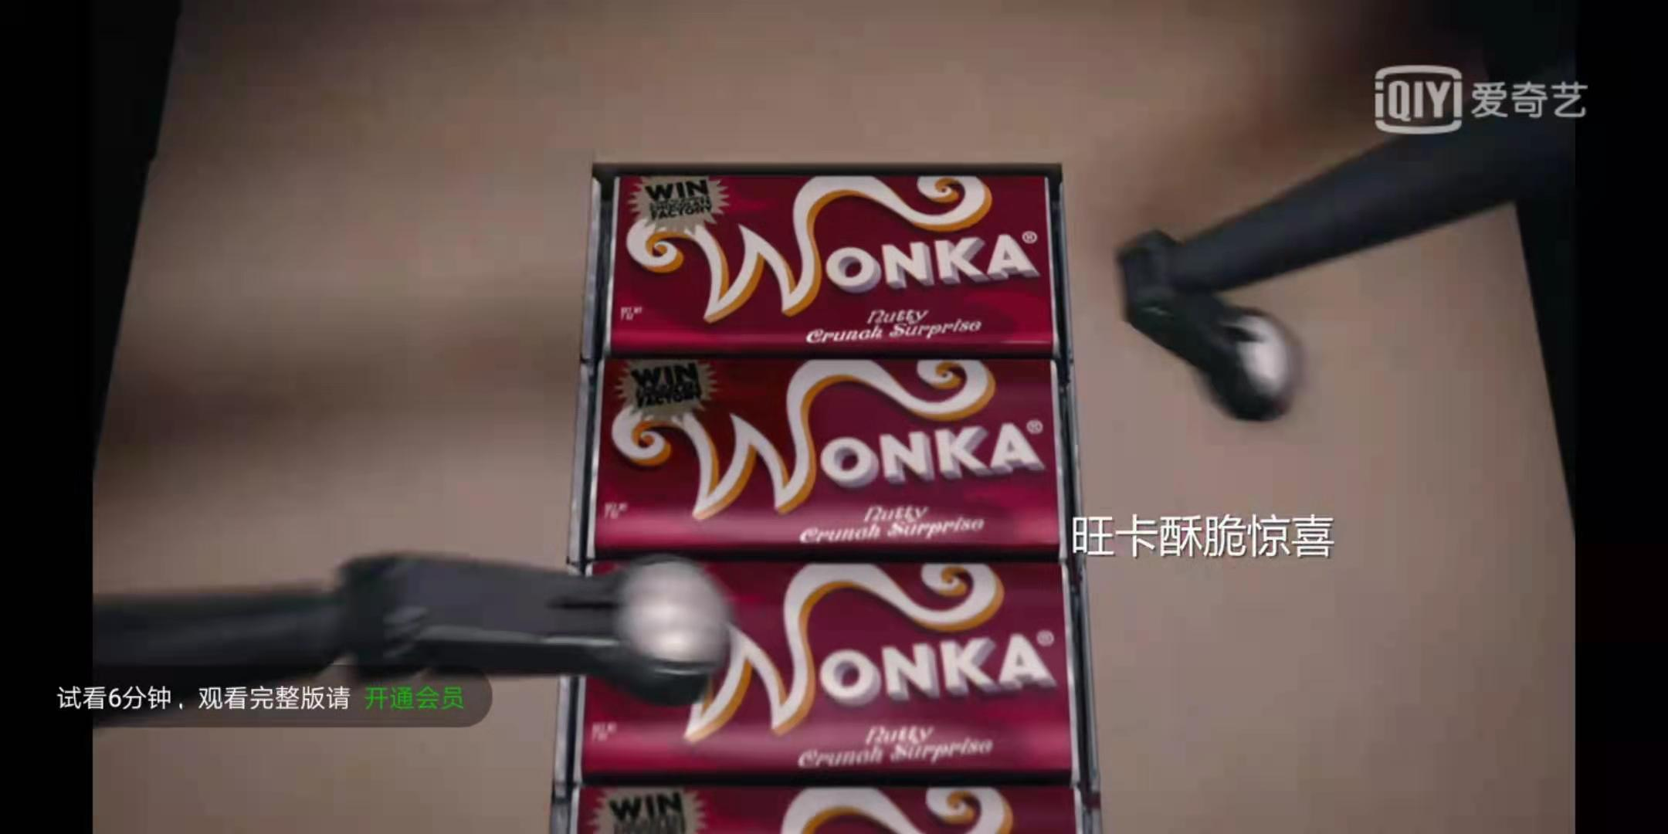
Reading for basic information:
Where :
Who/What :
in a chocolate store
the fat shopkeeper
excited people
Charlie
Wonka's Whipple-Scrumptious Fudgemallow Delight

Slide 3
Reading for important details and analyzing the personalities of the main characters:
Charlie:
…remembering how much he had loved the one he had on his birthday.
2. … grabbed … quickly tore off … took an enormous bite. …took another … and another …the joy of being able to cram … into …!
3. … went on wolfing …couldn't stop. … in less than half a minute, … had disappeared … quite out of breath, but … marvelously, extraordinarily happy.
4…. reached out … paused… staring at …
Surely it wouldn't matter if he spent just one more.
seldom ate
poor
only on birthday

Slide 4
a child who really loving to eat chocolates
might come from a poor family and seldom had the chance to eat chocolate
3. considerate and very careful about spending money
4. might be very hungry at that time
the personality of
Charlie

Slide 5
The fat shopkeeper:
1."You look like you wanted that one, sonny.“ the shopkeeper said pleasantly.
2. The shopkeeper put Charlie's change on the counter. "Take it easy.“ he said. "It'll give you a tummy-ache if you swallow it like that without chewing."
3. “Watch out now, sonny! Don’t tear it as you unwrap it. The thing is precious!”
kind, caring, pleasant(和蔼的),...
和蔼的:pleasant, nice, kind,
amiable, genial

Slide 6
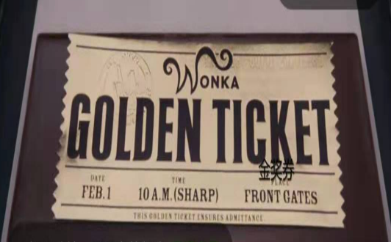
Read for main plot:
1. Charlie entered the shop.
Reactions
2. Charlie asked the shopkeeper for a chocolate bar.
Charlie
Shopkeeper
His heart
stood still.
He screamed,
leaping about a
foot in the air.
3. Charlie ate it.
4. Charlie asked for one more.
？
shocked
startled
excited;
overjoyed
5. Charlie found the Golden Ticket.

Slide 7

You've found the last Golden Ticket! You will be one of the five lucky children to be shown around Wonka's chocolate factory…That thing is precious!“
a precious ticket ;
a chance hard to get

Slide 8
Continue writing:
What will be conveyed in the end of the passage?
echo
the title: The Miracle
The ending
1. That night, Charlie held the precious Golden Ticket into sleep. In the dream, the river of sweet chocolate streamed out of the strange machines, the sweet smell lingering around the big factory. What a miracle for a lucky boy!
2. At night, Charlie laid on the bed with a sweet smile. Never would we know the taste of next chocolate in our life, but the chocolate full of expectation always tastes best. /Life is a box of chocolate. You’ll never know what you are going to get. What a miracle!
3. Charlie nodded and thanked the shopkeeper, running along the street towards home with exhilaration. He would tell his family the incredibly miraculous news!
Possible endings:

Slide 9
Tt was really a miracle for Charlie to be blessed with a visit to Wonka’s chocolate factory and a pleasant friend who loved chocolate bar as loyally as he did--the shopkeeper.(Q)

Slide 10
保持与前文的协同度：
And as he flew past Mr. Willy Wonka's chocolate factory, he turned and waved at it and sang out, "I'll be seeing you! I'll be seeing you soon! "And five minutes later he arrived at his own home， giving the rest of the money to his parents.

Slide 11
Continue writing:
Paragraph1:Charlie hadn't moved.
What did he do?
…standing still, holding the Golden Ticket tightly …
What did he see and hear?
…the crowd pushing and shouting …
How did he feel?
…dizzy…a peculiar floating sensation …his heart thumping ….
What happened at the end of Paragraph1?
第一段主要是Charlie得到奖票之后面对疯狂的人群时所做所见所想所感: do; see; hear; feel

Slide 12
Continue writing:
What happened at the end of the first paragraph?
Paragraph 2: Then the fat shopkeeper shouted, pushing his way through the crowd and taking Charlie firmly by the arm.

Slide 13
Continue writing:
What happened at the end of the first paragraph?
Paragraph 2: Then the fat shopkeeper shouted, pushing his way through the crowd and taking Charlie firmly by the arm.
1.The frenzied/frantic/crazy crowd jostled(推挤,争夺/swarmed(蜂拥)/scrambled for the ticket.
The situation seemed to be out of control.(the crowd）
2. Feeling the crazy emotions of the crowd, Charlie felt a sense of fear floating into his heart, he shouted at the shopkeeper for help at the top of his lungs.（Charlie)
3.Standing beside, the shopkeeper couldn’t bear so many people cheating such an innocent boy.(keeper)
Possible sentences:

Slide 14
Paragraph 2:Then the fat shopkeeper shouted, pushing his way through the crowd and taking Charlie firmly by the arm.
What did the shopkeeper shout to the crowd?
'‘… quite enough …! Leave the kid alone…! Make way there! Let him out!”
What did the shopkeeper say to Charlie?
…take good care of …, run and take …straight home ...
How did Charlie respond?
… nodded and thanked …, accelerating his steps, eager to tell ….
the crowd
interaction
the shopkeeper
Charlie

Slide 15
连接成文:
Charlie hadn't moved. Standing very still, he held the Golden Ticket tightly with both hands. The crowd pushing and shouting all around him, he could hear his heart thumping away loudly somewhere in his throat. Suddenly, he felt quite dizzy. There was a peculiar floating sensation coming over him, as though he were floating up in the air like a balloon. His feet didn't seem to be touching the ground at all. Feeling the crazy emotions of the crowd, Charlie felt a sense of fear floating into his heart, he shouted at the shopkeeper for help at the top of his lungs.

Slide 16
Then the fat shopkeeper shouted, pushing his way through the crowd and taking Charlie firmly by the arm. ''That's quite enough of that! Leave the kid alone, will you! Make way there! Let him out!” Leading Charlie out to the street, the shopkeeper softly told him to take good care of the Golden Ticket, run and take it straight home quickly before he lost it! Charlie nodded and thanked the shopkeeper, accelerating his steps, eager to tell his family the incredibly exciting news. That night, Charlie held the precious Golden Ticket into sleep. In the dream, the river of sweet chocolate streamed out of the strange machines, the sweet smell lingering around the big factory. What a miracle for a lucky boy!

Slide 17
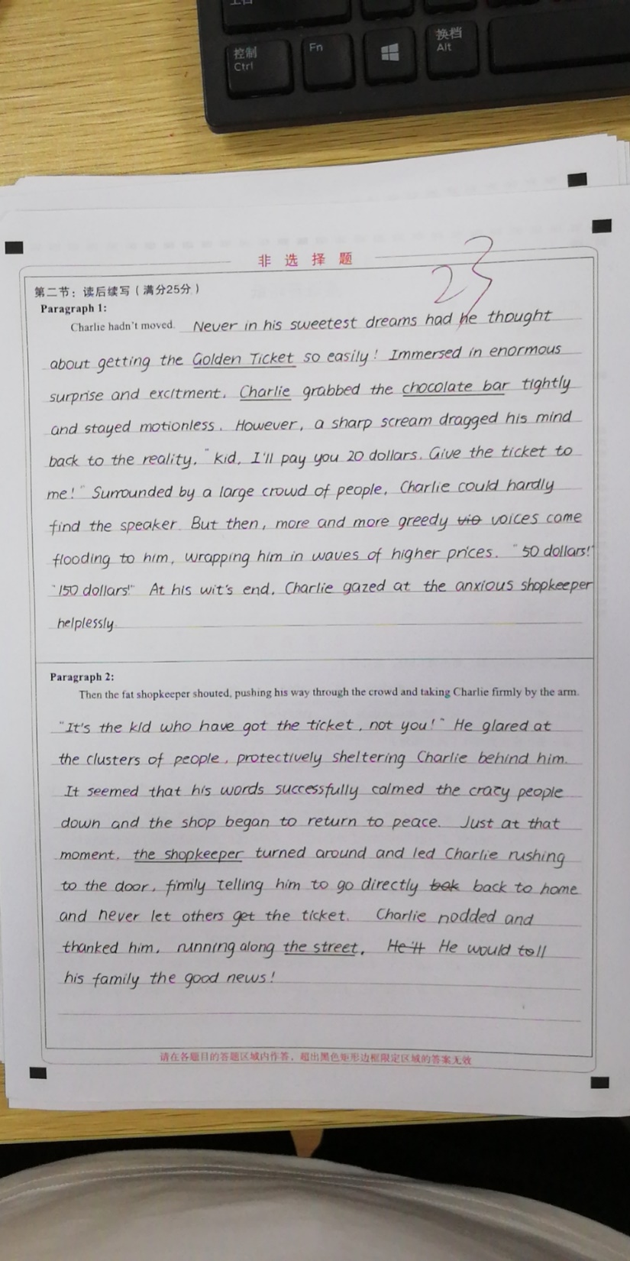
学生习作1：

Slide 18
Para1:Charlie hadn't moved. Never in his sweetest dreams had he thought about getting the Golden Ticket so easily! Immersed in enormous surprise and excitment, Charlie grabbed the chocolate bar tightly and stayed motionless. However, a sharp scream dragged his mind back to the reality. “kid, I'll pay you 20 dollars. Give the ticket to me!” Surrounded by a large crowd of people, Charlie could hardly find the speaker. But then, more and more greedy voices came flooding to him, wrapping him in waves of higher prices. “50 dollars!” “150 dollars!" At his wit's end, Charlie gazed at the anxious shopkeeper helplessly.

Slide 19
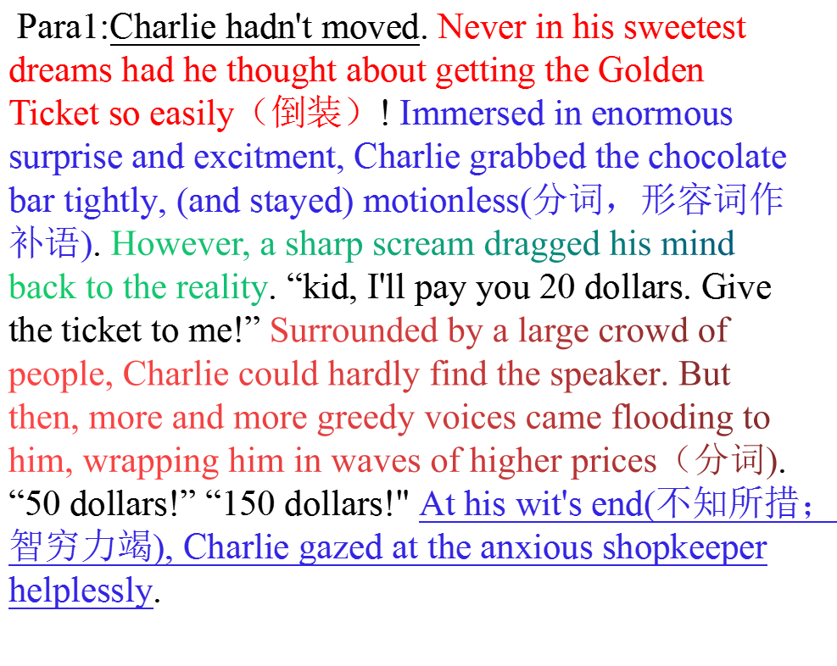

Slide 20
Paragraph 2: Then the fat shopkeeper shouted. pushing his way through the crowd and taking Charlie firmly by the arm. "It's the kid who have got the ticket. not you! "He glared at the clusters of people, protectively sheltering Charlie behind him. It seemed that his words successfully calmed the crazy people down and the shop began to return to peace. Just at that moment, the shopkecper turned around and led Charlie rushing to the door, firmly telling him to go directly back to home and never let others get the ticket. Charlie nodded and thanked him, running along the street. He would tell his family the good news!

Slide 21
Paragraph 2: Then the fat shopkeeper shouted. pushing his way through the crowd and taking Charlie firmly by the arm. "It's the kid who have (has) got the ticket. not you! "He glared at the clusters of people, protectively sheltering Charlie behind him. It seemed that his words successfully calmed the crazy people down and the shop began to return to peace. Just at that moment, the shopkecper turned around and led Charlie rushing (to rush) to the door, firmly(?) telling him to go directly back (to) home and never let others get the ticket. Charlie nodded and thanked him, running along the street. He would tell his family the good news!（miracle？）

Slide 22
学生习作1：
这篇习作得分23。整体书写卷面漂亮。第一段第一句与标题miracle呼应。整篇文章情节合理语言结构丰富，准确使用倒装句，过去分词，现在分词等。Charlie得到奖票的兴奋心理刻画细腻。一二两段衔接自然。第二段后半部分语言还可提升，若在最后再次点题会更好。

Slide 23
Appreciation
续写原文语言欣赏
外貌描写：
1. The fat around his neck bulged out all around the top of his collar like a rubber ring.
动作加心理描写：
2.Charlie grabbed it and quickly tore off the wrapper and took an enormous bite. Then he took another … and another…and oh, the joy of being able to cram large pieces of something sweet and solid into one‘s mouth!
3.Charlie went on wolfing the chocolate. He couldn't stop. And in less than half a minute, the whole thing had disappeared down his throat. He was quite out of breath, but he felt marvelously, extraordinarily happy.

Slide 24
Appreciation
续写原文语言欣赏
动作描写
4. In a few seconds, there was a crowd of about twenty people clustering around Charlie, and many more were pushing their way in from the street.
5. Charlie nodded, his mouth bulging with chocolate.
6. “It‘s a Golden Ticket!“ screamed the shopkeeper, leaping about a foot in the air.
心理描写
7. Charlie‘s heart stood still.
副词
8. … the shopkeeper said pleasantly.
和蔼的:pleasant, nice, kind, amiable, genial

Slide 25
Then one afternoon, walking back home with the icy wind in his face (and incidentally feeling hungrier than he had ever felt before ), his eye was caught suddenly by something silvery lying in the gutter, in the snow. Charlie stepped off the kerb and bent down to examine it. Part of it was buried under the snow, but he saw at once what it was it was a fifty-pence piece!
Quickly he looked around him.
Had somebody just dropped it?
No-that was impossible because of the way part of it was buried.
Several people went hurrying past him on the pavement, their chins sunk deep in the collars of their coats, their feet crunching in the snow. None of them was searching for any money; none of them was taking the slightest notice of the small boy crouching in the gutter.
Then was it his, this fifty pence?
Could he have it?

Slide 26
Carefully, Charlie pulled it out from under the snow. It was damp and dirty, but otherwise perfect.
A WHOLE fifty pence!
He held it tightly between his shivering fingers, gazing down at it. It meant one thing to him at that moment, only one thing. It meant FOOD.
Automatically, Charlie turned and began moving towards the nearest shop. It was only ten paces away... it was newspaper and stationery shop, the kind that sells almost everything including sweets and cigars, and what he would do, he whispered quickly to himself...he would buy one luscious (having a strong pleasant taste) bar of chocolate and eat it all up, every bit of it, right then and there...
and the rest of the money he would take straight back home and give to his mother.

Slide 27
续写备考建议：
1.对于续写文本，同学们要学会快速理出故事基本要素：who，when，where， what, why, how 等。
2.重点解读：1)重点细节；2)主要情节发展；3)所给段落首句的关键词，寻找续写点；4)原文文本最后一段的文字要特别关注，找到延续下文的续写点
3. 如果有标题，可以利用标题推断文章主旨方向；如果没有标题可以先通读文本，概括每段大意，确定主题或文章结尾，然后推断出前面情节。
4.书写，排版和修正
如何寻找续写点：
1）.通过从原文中去寻找重点细节和主要情节来找到续写点；
2）.从第二段首句推断出第一段末尾的情节；
3）.从所给两段首句的关键词中找到设问点来一步一步推断出情节从而推动故事发展。
最后20多天，同学们要不懈努力，多多练习写作思路。加油！！！Fighting！！！

Slide 28
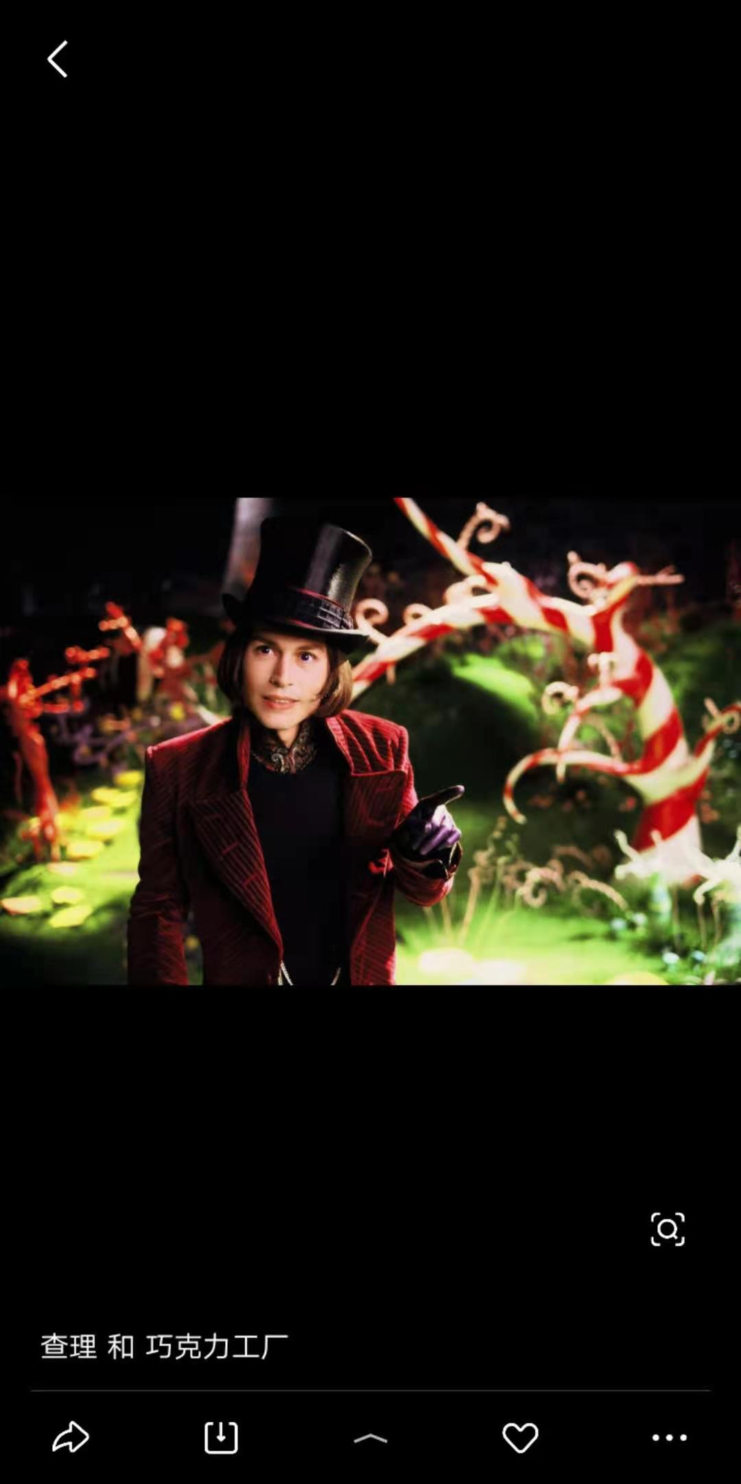
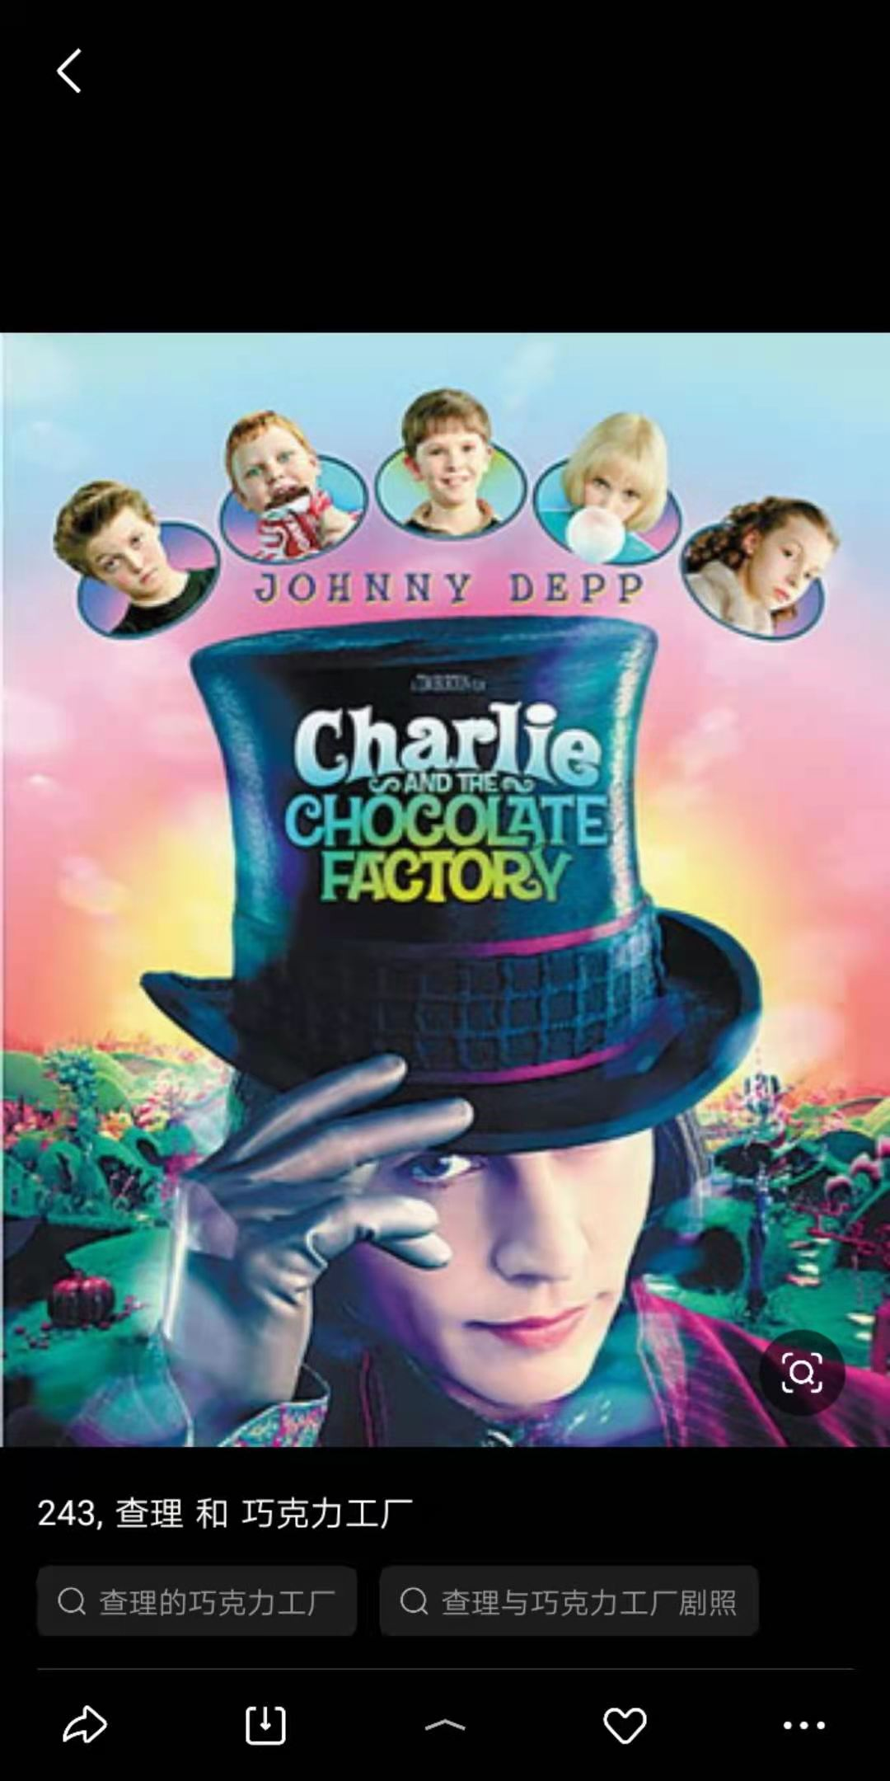

Thank you!

